Slide 1
Code to Connect 2024 Presentation Deck
Group 3
Jim, Shu Heng, Zi Xiang

Slide 2
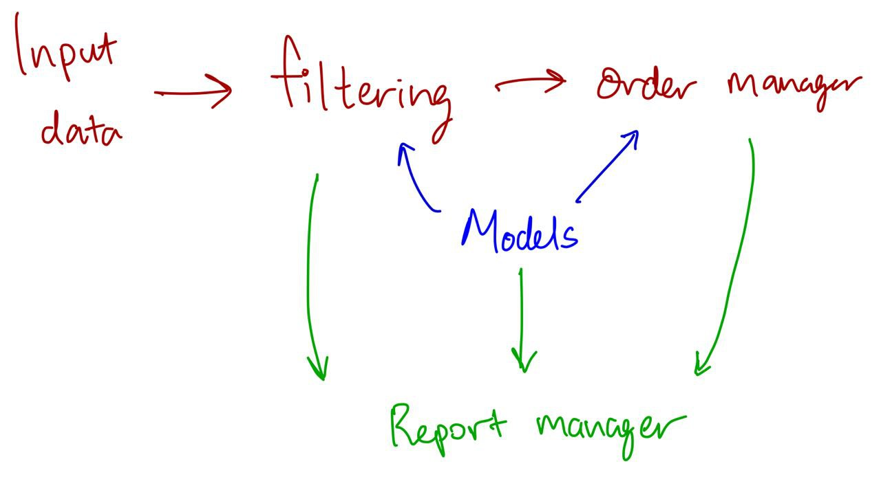
Solution Overview & Design
4 main components:
Filtering manager
Read input data and clean the data (remove orders failing checks 1,2 or 3)
Models
Modelling key parts of the problem statement: Clients, Instruments, Orders
Order manager
Handles the matching, containing relevant algorithms and data structures
Report manager
All other components update the report manager, which will produce the final report at the end of the trading day.

Slide 3
Design of models and order manager
Each client keeps track of # of units of each instrument that it has.
Each instrument has a buy heap, sell heap, buy array and sell array. Arrays are used to store market orders, buy and sell heap for limit orders.
We keep track of rejected orders for the end of trading day report.
------------------------------------------------------------------------------------------------------------
Order manager takes in filtered data and runs our matching algorithm:
Our implemented solution is in the next slide, and a proposed, more efficient solution (which we had no time to write) will be given in the following slide.

Slide 4
Implemented solution for order manager
Filter inputs: If order fails any of the 3 checks (instrument, currency, lot size), we reject the order (logged by record manager)
Now, we go through each filtered order. When an order comes in…
Sell order – For clients that require checks, check their positions to ensure no short selling.
Limit order: If it’s a buy order, we throw it into a buy heap. Sell orders go to a sell heap. This heap will do the heavy-lifting for sorting the orders: a custom comparator is used to sort the orders by price, client rating, arrival time (in that order).
We match the top element of the buy & sell heap repeatedly until the heap is empty and no more valid matches are found.
MKT order: Check the opposing heap / store unfilled orders in an array of queues. E.g. a MKT buy order checks the sell heap for a match. If there’s a match, i.e. an order exists in the heap, we perform the transaction. If no match, store the unfilled MKT order into an array. The array index is the client rating and each array element is a queue, for FIFO ordering of the MKT orders.
while (not df.empty()) {
Take the next order.
Sell order: If client requiresCheck, check for qty available, reject invalid order.
If (order is MKT) {
Check opposing PQ for a match.
Match: Transact. PQ may be reshuffled if all orders at the price are consumed.
No match: Store into array of queues.
} else { // Is a limit order
Add order into PQ.
Check opposing MKT array – if there’s a match, we transact. PQ may be reshuffled.
If MKT array empty, we check opposing PQ for a match. Transact if there’s a match, else do nothing
}
}
Time complexity analysis
While loop: O(M)
M is size of the dataframe
O(1)
O(log N)
N is size of the heap
O(log K)
K is size of the queue
O(log N)
O(1)
O(1), or
O(log N) [if PQ reshuffled]
Overall: O(M * (log N + log K))

Slide 5
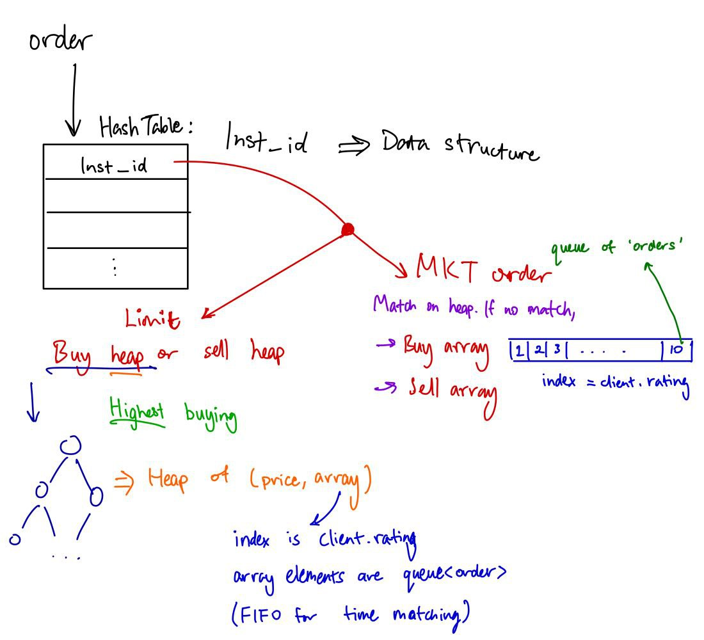
Proposed Solution design - Walking through an order
Order comes in.
HashTable maps INST_ID to a data structure (Array for MKT order and heap for Limit order).
MKT order: similar to previous slide.
Limit order: There will be a buy heap and a sell heap. Each node is a pair of (price, array) and the heap is sorted by the price. Each heap has its own ‘cache’ (a hashmap to keep track of prices existing in the heap). If the price doesn’t exist, add a new node.
…..The array in each node is of size 10, …..where array index represents client …..rating and each element is a queue …..(for time matching, as per previous …..slide). Now, we access the queue to …..find our orders.

Slide 6
Reports and screenshots of demo

